Slide 1

UBER DATA ANALYSIS

Slide 2
Objective
The main objective of this project is to use exploratory data analysis on the dataset to better understand and display the data, and then using machine learning algorithms to determine the most accurate model for prediction of price.

Slide 3
Methodology and Framework
Data Preparation
Data Visualization
Data Cleaning
Data Modelling
Data Testing

Slide 4
Data Preparation
The data we used for this study was obtained from the Kaggle website. The original dataset has 693071 rows and 57 columns, and it includes Uber and Lyft data.
However, we only need the Uber data for our study, so we filtered the data for our needs and created a new dataset with 322844 rows and 56 columns.
The dataset contains several fields that tell us about the time, location, and weather conditions when the various Uber cabs were used.

Slide 5
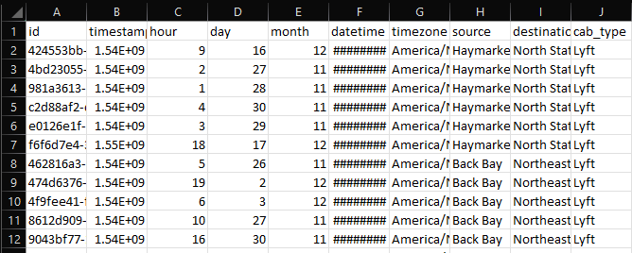
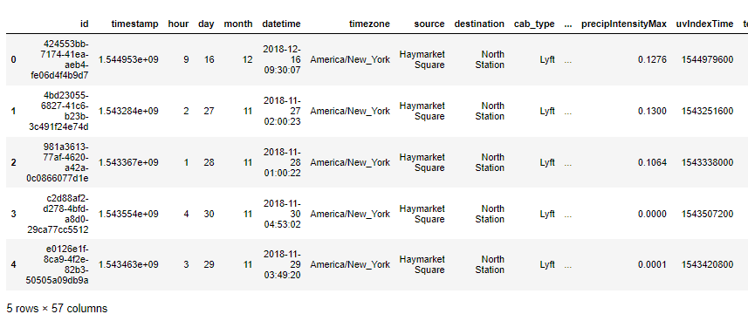
Raw data
Imported data

Slide 6
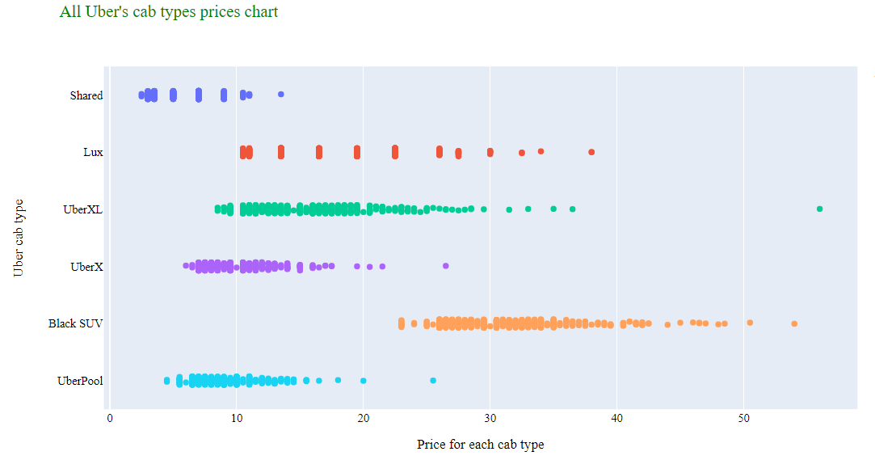
Data Visualization
A graphical depiction of information and data is known as data visualization.
Visualization tools make it easy to examine and understand trends and patterns in data by employing visual elements like charts, graphs, and maps.
The graph shown were made using the dataset.

Slide 7
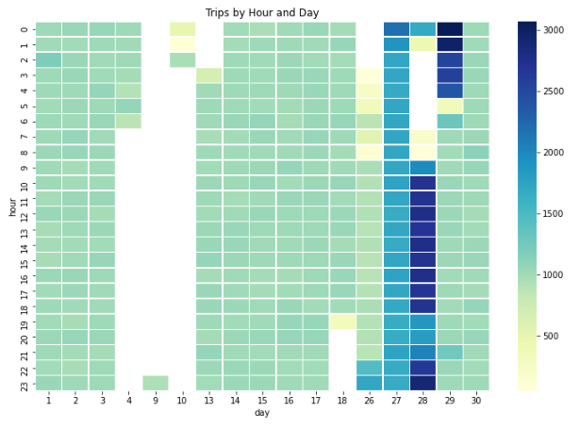
Heat map visualization by day and hour

Slide 8
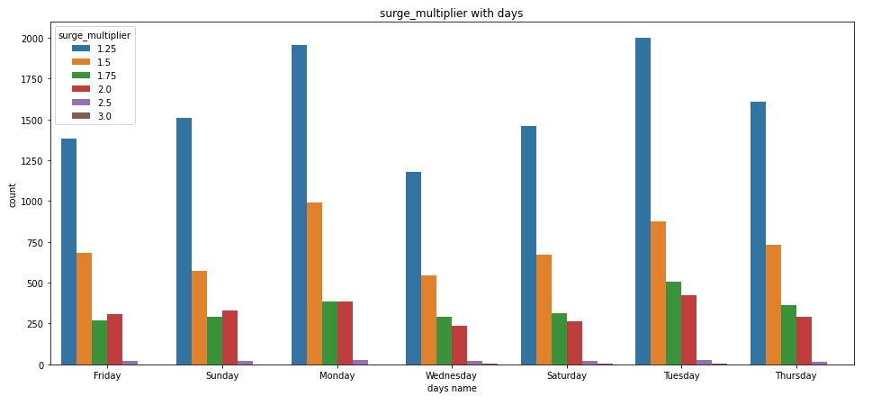
Surge multiplier with days

Slide 9
Data Cleaning
Label Encoding
Filling NAN values
Recursive Feature elimination
Drop useless columns
Binning
The most important step in the data analytics process is data cleaning. It is necessary to decide which features to employ in training and creating predictions.
This is done by label encoding, filling nan values, RFE, dropping useless columns and binning.

Slide 10
Data Modelling
Data modelling is the process of training a machine-learning algorithm to predict the labels from the features, tuning it for the business needs, and validating it on holdout data.
When you use data to train an algorithm, it becomes a model. The accuracy of all machine learning models is a crucial aspect to consider.
To verify their accuracy, one can train the model using the given dataset and then use that model to predict the response values for the same dataset, hence determining the model's accuracy.

Slide 11
Various machine learning algorithms
Linear Regression
Decision tree

Slide 12
Data Testing
Machine learning applications are not 100% accurate.
Hence testing is required. Testing is a subset or part of the training dataset that is built to test all the possible combinations and estimates how well the model trains.
So therefore, by using data testing we can increase the efficiency and accuracy of the algorithm that is used to train the machine.

Slide 13
Conclusion
Before working on features first we need to know about the data insights which we get to know by EDA.
Apart from that, we visualized the data by drawing various plots, in which we understood that we don’t have any data for taxi’s price. This problem is rectified by using different data cleaning techniques.
And found the best algorithm by using the accuracy of models.
Then We applied the two different machine learning algorithms to our remaining dataset.

Slide 14
Thank You

